Slide 1




Coursera Capstone Project
Determining the Best Neighborhoods to Open a Restaurant in Toronto and New York
By Jeffrey Lu
August 2019

Slide 2
Introduction
Objective: To decide what neighborhoods within New York and Toronto are the best locations to open a restaurant.
Audience: Restaurant owners whose businesses are especially weather-sensitive ie.) Ice Cream shops, Hot Pot Restaurants, Pizzerias.
Data: We will leverage weather data from OpenWeatherMap and venue/location data from FourSquare

Slide 3
Data
Weather Data
Source: OpenWeatherMap
Data: 5 day forecast every 3 hours for temperature, humidity, and weather condition (ie. Light rain, clear sky, cloudy, etc.)
Added Fields: 5 day average temperature, 5 day average humidity, most frequent weather condition, Clear Sky frequency
Venue Data
Source: Foursquare
Data: Venue Data
Added Fields: Total Number of Restaurants, Total Restaurant Frequency

Slide 4
Methodology
Webscraping Wikipedia page for Toronto postal codes
Downloading New York location data from NYU
Obtaining latitude and longitude coordinates from Geocoder
Utilize Foursquare API for venue data
Group by Neighborhood and calculate mean frequency of each venue
Perform k-means clustering on dataset
Utilize OpenWeatherMap API for weather data and merge data onto the dataset we had before we grouped by neighborhood and calculated the mean frequency of each venue
With current data, calculate total number of restaurants, total frequency of restaurants, average 5 day forecasted temperature, average 5 day forecasted humidity, most frequently seen 5 day weather condition, and frequency of the ”Clear sky” condition.
Sort dataset for Toronto and New York by highest total restaurant frequency with the total number of restaurants being greater than or equal to ten.
Analyze to see if there are spark differences in the weather data between neighborhoods and cities

Slide 5
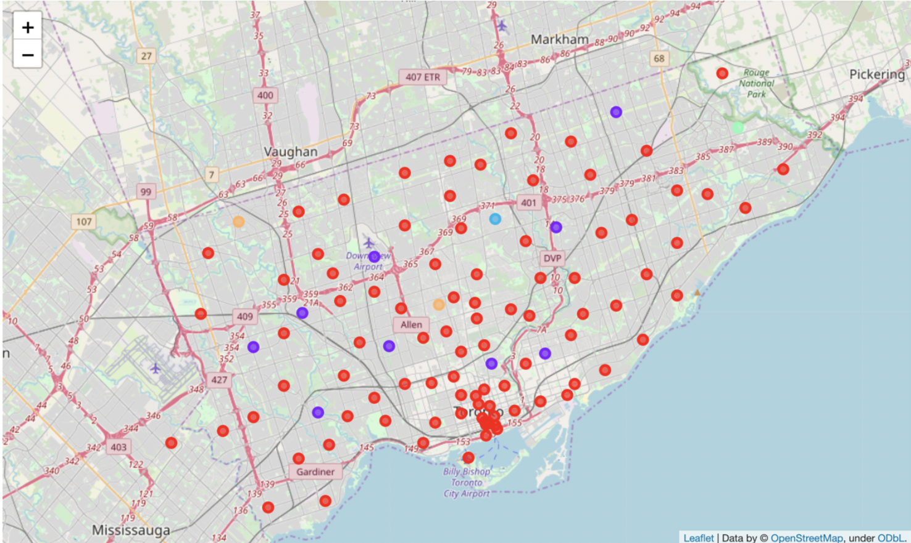
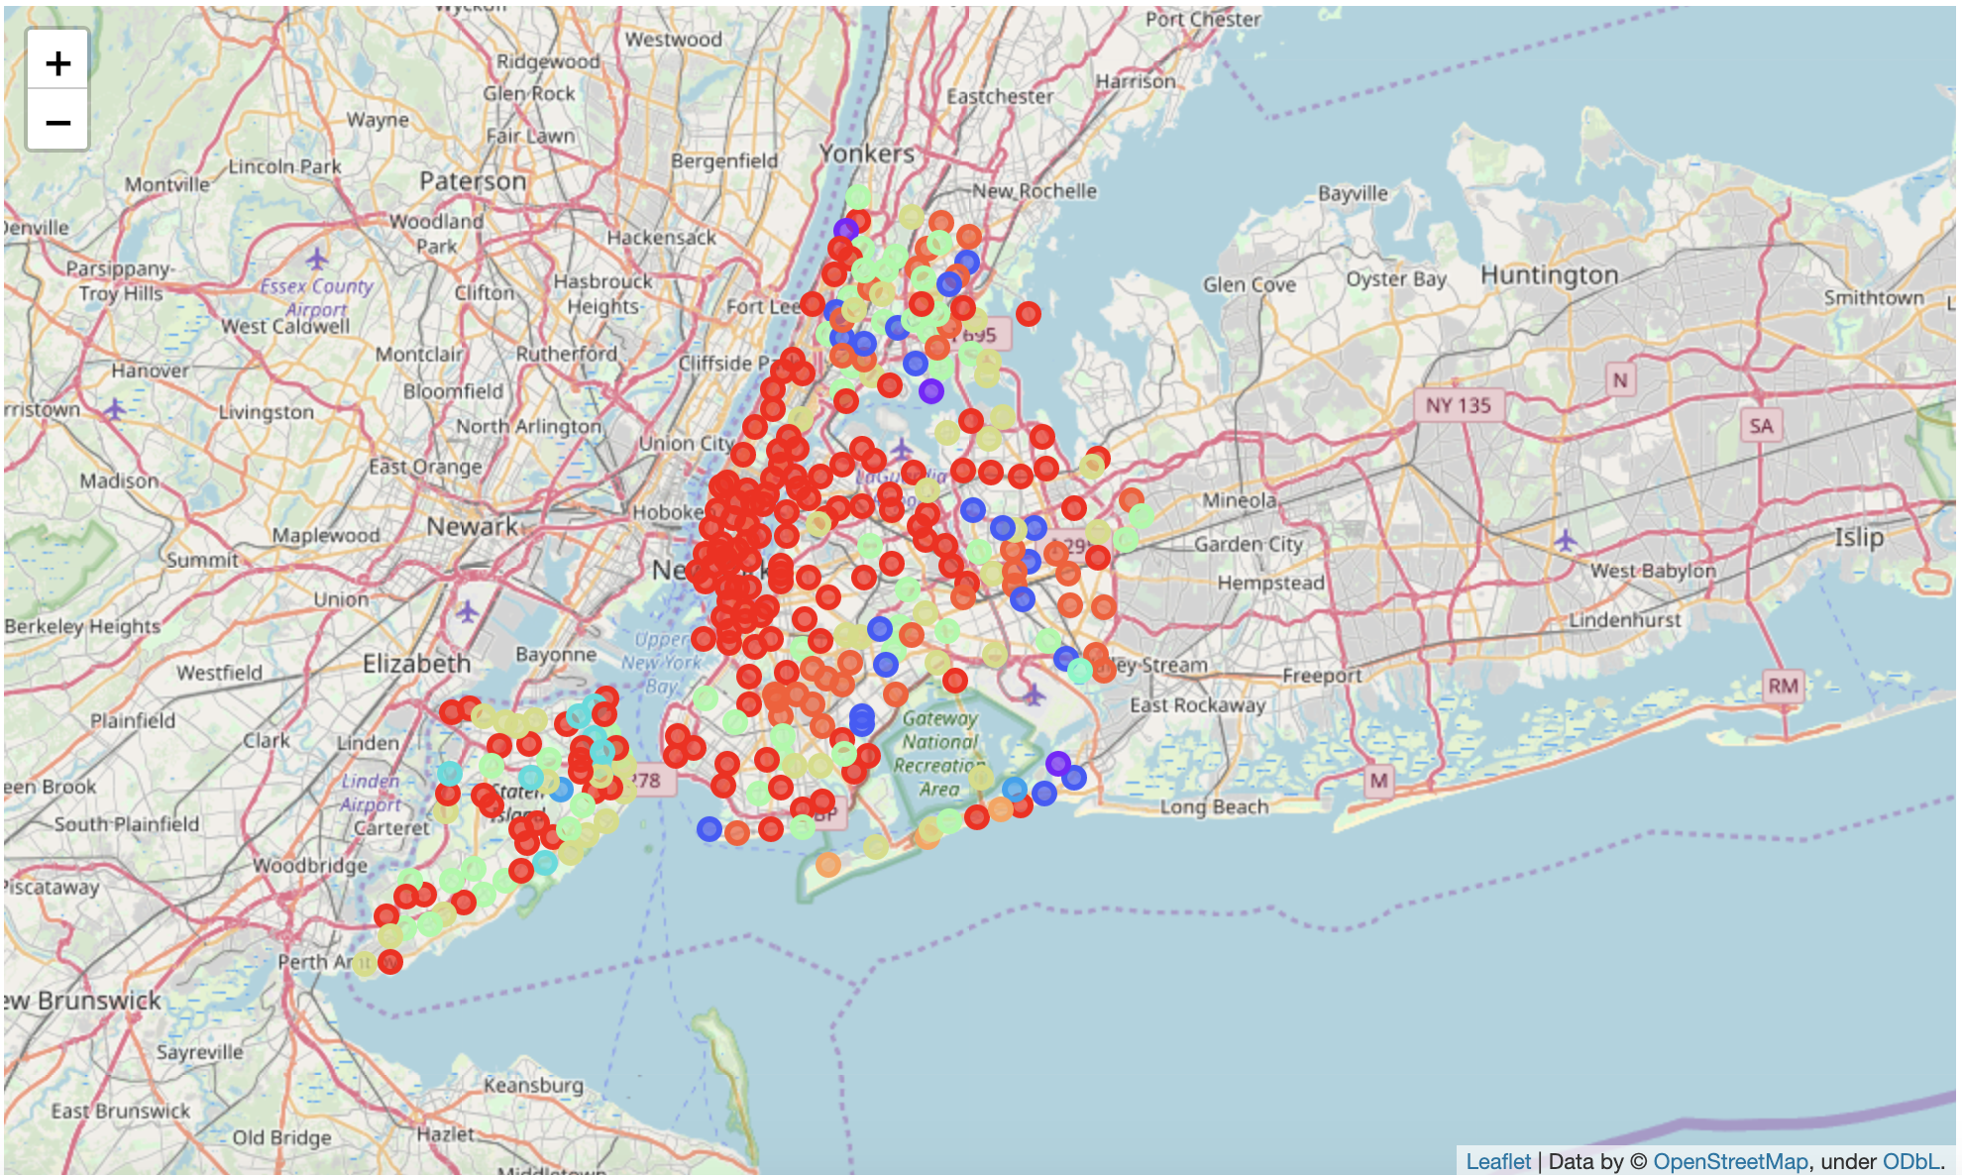
Results & Discussion 1: Toronto vs New York Clustering
Toronto’s heaviest cluster group, shown with the red color, reveals that these areas are full of restaurant’s, coffee shops, and bars.
New York’s clusters reveal more restaurant related clusters. Cluster 1 (red) are full of neighborhoods with a plethora of diverse restaurants. Cluster 7 (green) features neighborhoods with an extremely high frequency of pizzerias and cluster 10 (orange) showcases neighborhoods with a high frequency for Caribbean restaurants and donut shops.

Slide 6
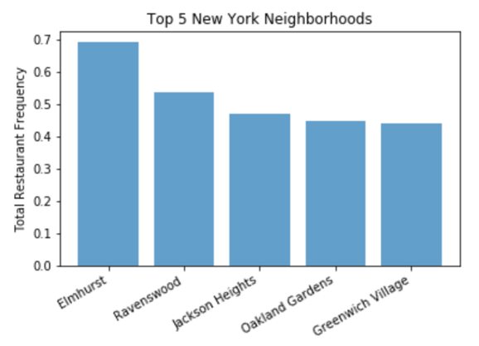
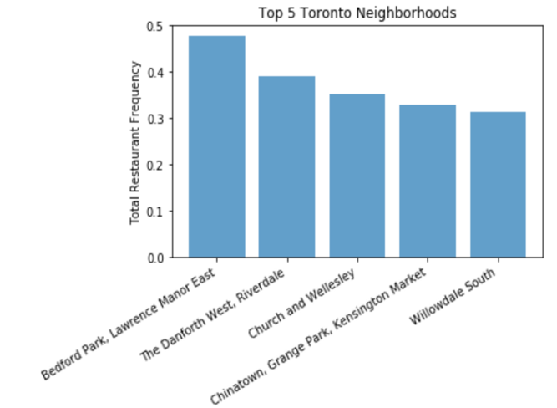
Results & Discussion 2 : Toronto vs New York Dataset
Elmhurst, Ravenswood, Jackson Heights, Oakland Gardens, and Greenwich Village all seem to be good spots when considering opening up a restaurant in New York
Bedford Park, Lawrence and Manor East would be the best place to open up a restaurant. However, the neighborhoods of Church and Wellesley, Chinatown, Grange Park, and Kensington Market of Downtown Toronto also seem to be fantastic.

Slide 7
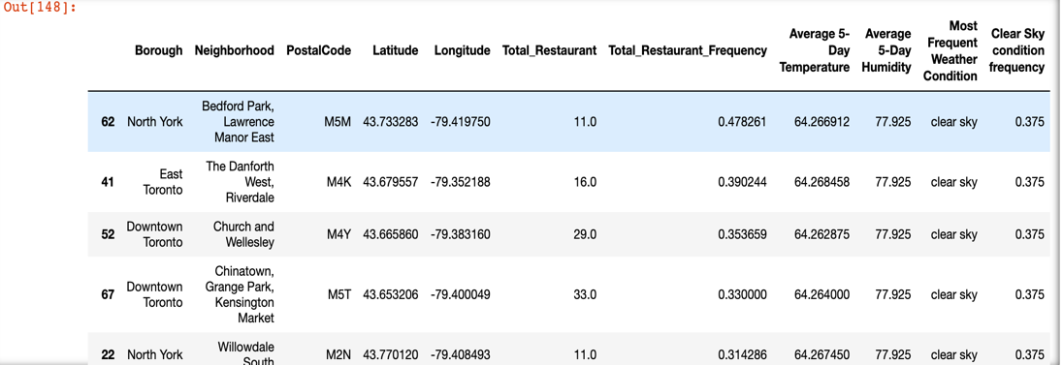
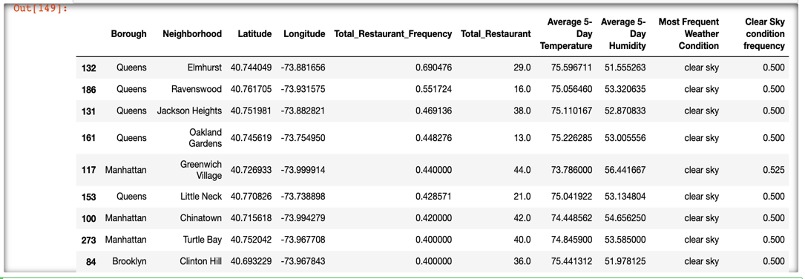
Results & Discussion 3 : Toronto vs New York Dataset
New York is the better than Toronto when it comes down to opening up a restaurant, given the information in this dataset
New York’s total restaurant venue frequency, total number of restaurants, the temperature, and frequency of the clear sky condition all seem to be higher and the humidity forecast seems to be lower. All of these factors seem to make New York a better place to open a restaurant.

Slide 8
Limitations and Considerations
Other factors to consider when opening a restaurant not considered in this dataset: Per-capita income of the area, demographics, average rental cost-per-square foot, local supplier costs, and the possibility of an oversaturated market.
Since we are comparing different countries, we also need to consider currency fluctuations as well as where the countries are in its business cycle.
The most extensive and cost-free API forecast we were able to obtain from OpenWeatherMap is a 5-day forecast which in theory shouldn’t be sufficient enough to base any business decision off of.

Slide 9
Conclusion
The best neighborhoods to open a restaurant in Toronto would be: Bedford Park, Lawrence, Manor East, Church and Wellesley, Chinatown, Grange Park, and Kensington Market.
The best neighborhoods to open a restaurant in New York would be: Elmhurst, Ravenswood, Jackson Heights, Oakland Gardens, and Greenwich Village.
Restaurant owners can also consider the clustering analysis to gain deeper insight. For instance, if one if considering opening up specifically a pizzeria or Caribbean restaurant, they can consider neighborhoods residing in cluster 7 and 10 in the New York clustering analysis.

